Slide 1
PYTHON -2
PRITU A PATEL

Slide 2
What is Random Forest?
Random Forest is one of the most popular and powerful machine learning algorithms, used for both classification and regression tasks.
A random forest is essentially a collection (or “forest”) of decision trees trained on different subsets of the data.
Each tree in the forest is trained independently, and the final prediction is made by aggregating the predictions of all trees, either by taking the majority vote in classification or averaging the predictions in regression.

Slide 3
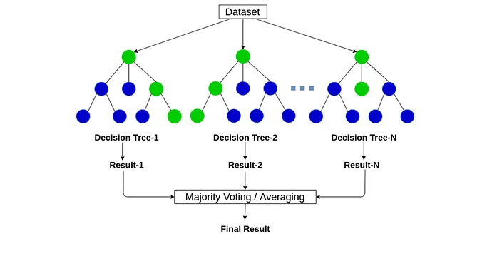
What is Random Forest?

Slide 4
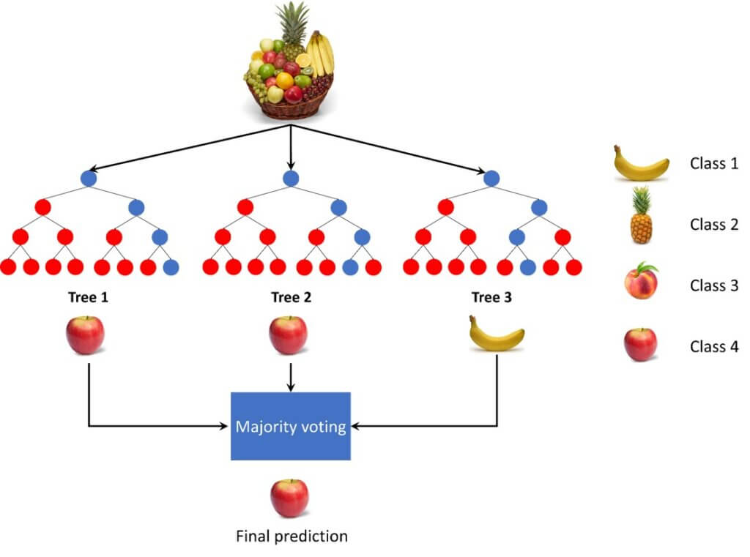
Example of Random Forest

Slide 5
KEY PARAMETERS OF RANDOM FORESTS
Number of Trees (n_estimators): This parameter specifies how many trees the random forest should include.
Tree Depth (max_depth): Limits the maximum depth of the individual trees.
criterion='entropy'

Slide 6
Implementing Random Forest
Step 1 : Import the Required Library
from sklearn.ensemble import RandomForestClassifier
Step 2: Load the Dataset (csv file)
Step 3: Data Cleaning & EDA (if required)
Step 4: Feature Selection single x and y variable (for simple linear Regression)
multiple features selection x and single y variable(for multilinear Regression)
Step 5: Model Selection (Data Split on train and test data)
x_train,x_test,y_train,y_test = train_test_split(x,y,test_size=0.2,random_state = 10)

Slide 7
Implementing Random Forest
Step 6 : Train the Random Forest Model
RFC=RandomForestClassifier(criterion='entropy',max_depth=3,n_estimators =100)
RFC.fit(x_train,y_train)
Step 7: Make Prediction
y_pred = RFC.predict(x_test)

Slide 8
What is Support Vector Machine ?
Support Vector Machine (SVM) is a supervised machine learning algorithm used for classification and regression tasks.
It tries to find the best boundary known as hyperplane that separates different classes in the data.
It is useful when you want to do binary classification like spam vs. not spam or cat vs. dog.

Slide 9
Key Concepts of Support Vector Machine
Hyperplane: A decision boundary separating different classes in feature space and is represented by the equation wx + b = 0 in linear classification.
Support Vectors: The closest data points to the hyperplane, crucial for determining the hyperplane and margin in SVM.
Margin: The distance between the hyperplane and the support vectors. SVM aims to maximize this margin for better classification performance.
Kernel: A function that maps data to a higher-dimensional space enabling SVM to handle non-linearly separable data.
C: A regularization term balancing margin maximization and misclassification penalties. A higher C value forces stricter penalty for misclassifications.

Slide 10
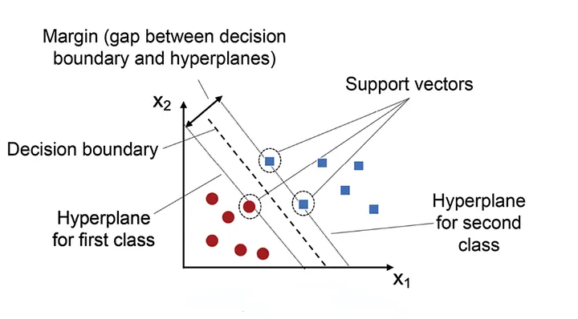
Key Concepts of Support Vector Machine

Slide 11
Implementing SVM
Step 1 : Import the Required Library
From sklearn.svm import SVC
Step 2: Load the Dataset (csv file)
Step 3: Data Cleaning & EDA (if required)
Step 4: Feature Selection single x and y variable (for simple linear Regression)
multiple features selection x and single y variable(for multilinear Regression)
Step 5: Model Selection (Data Split on train and test data)
x_train,x_test,y_train,y_test = train_test_split(x,y,test_size=0.2,random_state = 10)

Slide 12
Implementing SVM
Step 6 : Train the SVM Model
clf=SVC(kernal=rbf,C=1)
clf.fit(x_train,y_train)
Step 7: Make Prediction
y_pred = clf.predict(x_test)

